Slide 1
180° Fitness & Spa
DCSN 205 Project

Slide 2


Slide 3


The Problem
Meeting with Mrs. Samar Hamdan:
  Discussed possible problems at 180°
  Relied on previously solved problems in DCSN 2 05
Financing and accounting departments identified 4 problems:
  Electricity
  Water
  Laundry
  Capacity

Slide 4

Electricity Problem
5%-6% of total expenses goes to EDL
3%-4% of total expenses goes to electricity engines
Possible solution: Renewable energy
Monthly cost reduction: $42,000
Project costs: $95,000

Slide 5

Water Problem
4%-6% of total expenses goes to water expenses
2 procedures for possible solution:
  Water audit
  Informing employees
Monthly cost reduction: $35,000
Project costs: $70,000

Slide 6

Laundry Problem
4%-6% of total expenses goes to laundry expenses
Main issue: Ashour Holdings
  Elegance Laundry
Best solution: Insourcing a laundry facility
Monthly cost reduction: $35,000
Project costs: $70,000

Slide 7

Capacity Problem
Inefficient usage of the gym’s size
A need for layout strategy improvement
Best solution: Reallocating machines
Main contractor: Ashour Holdings
Monthly cost reduction: $75,000
Project costs: $120,000

Slide 8

The Data

Slide 9

Income Statements

Slide 10
Linear Programming Model

Slide 11
Decision Variables

Slide 12
Objective

Slide 13
Constraints

Slide 17
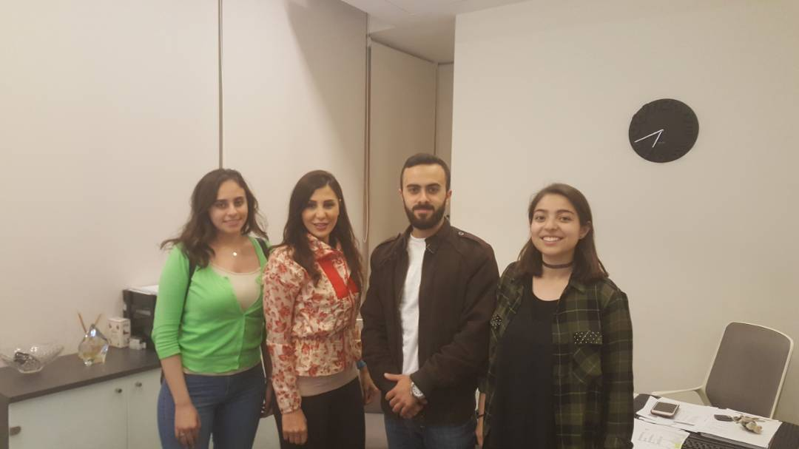
Thank You

